Slide 1

Tensorflow Implementation of (Manual) Gradient Descent

Slide 2
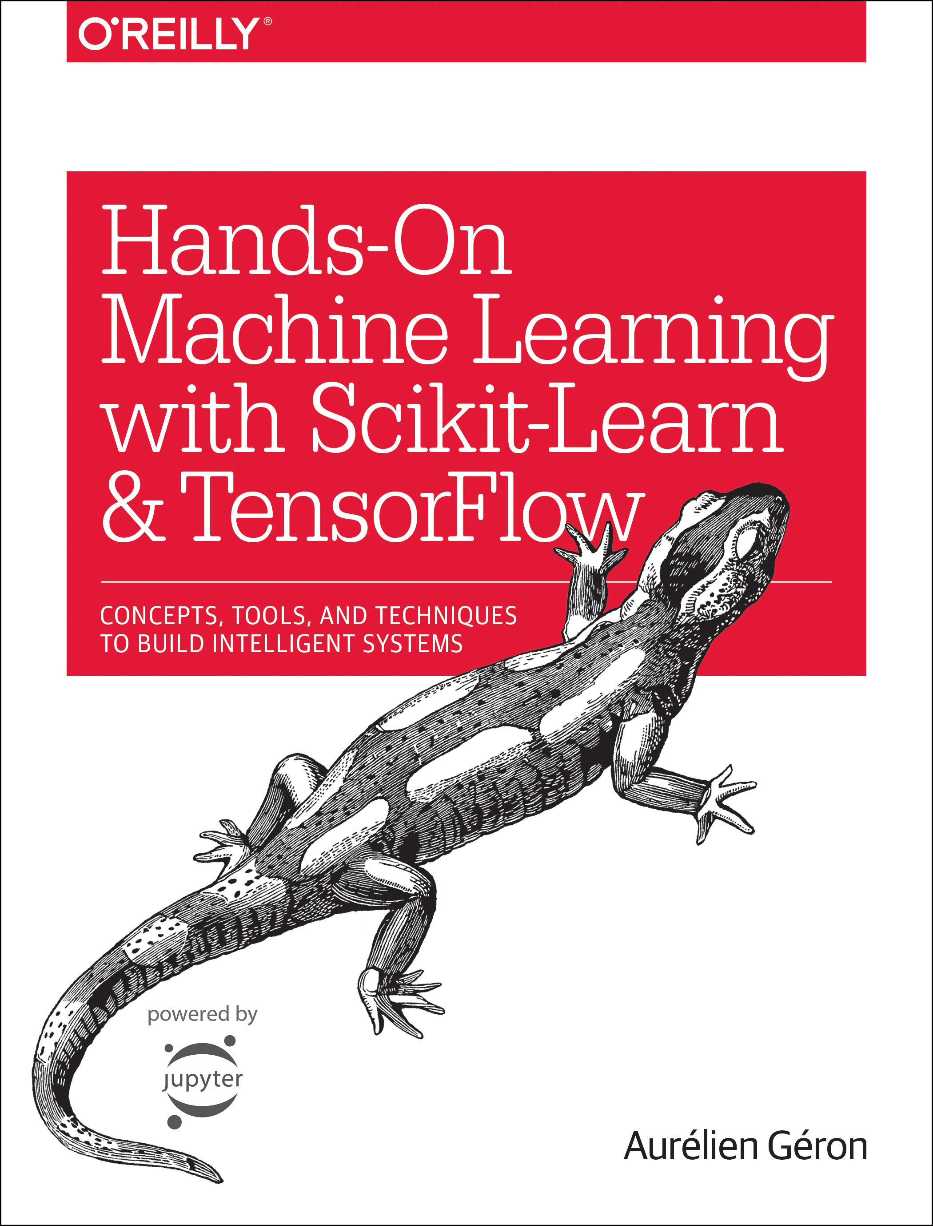
Reference
Chapter 9 (O'Reilly) of Hands-On ML
Youtube
Code

Slide 3
Data

Slide 4
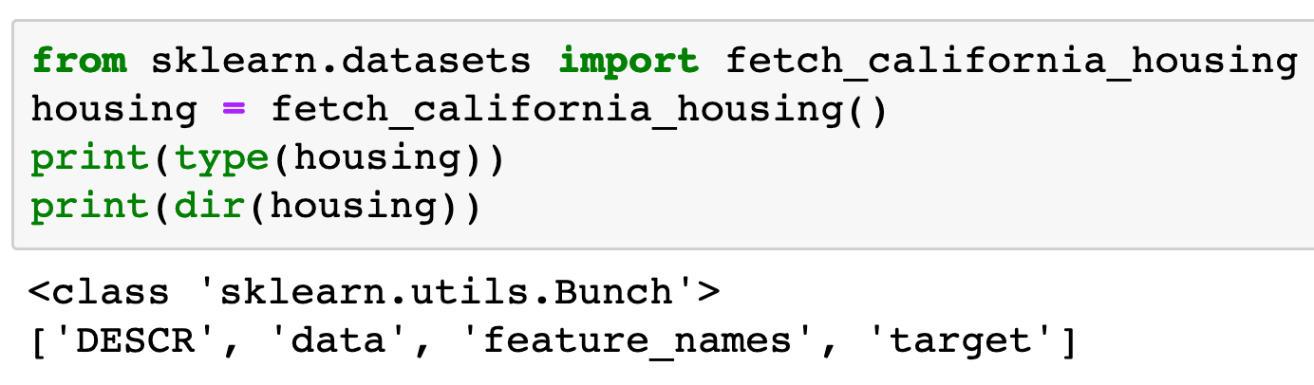

Slide 5
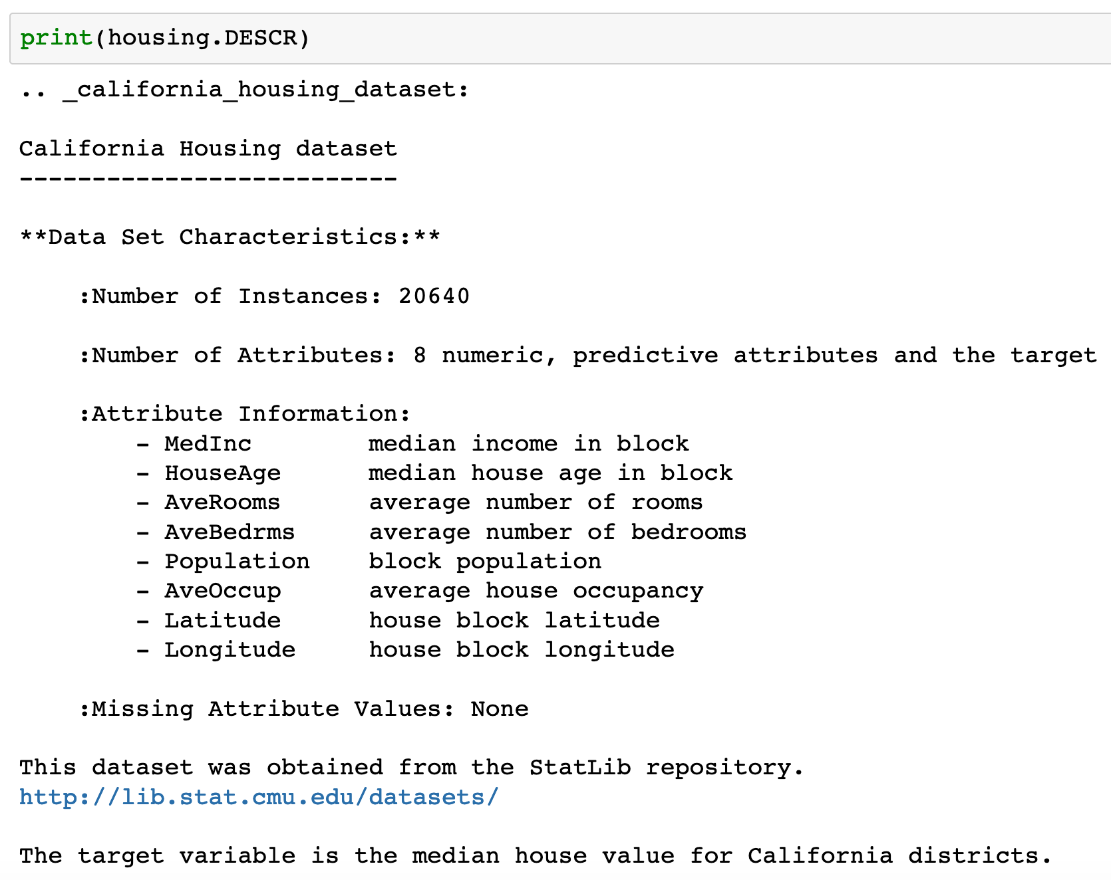

Slide 6
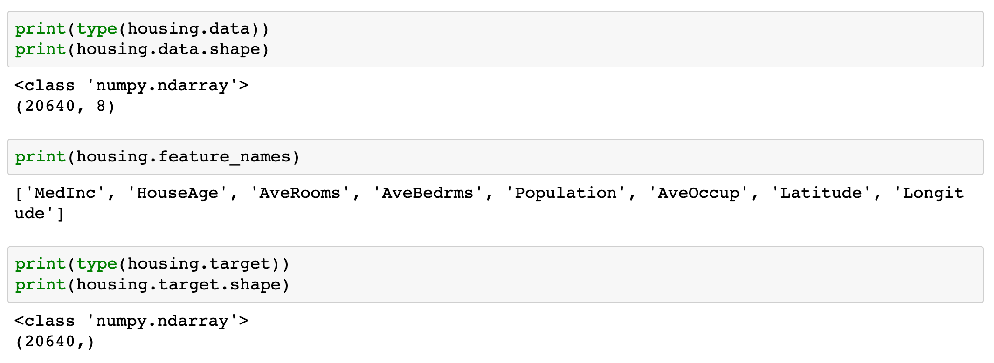

Slide 7
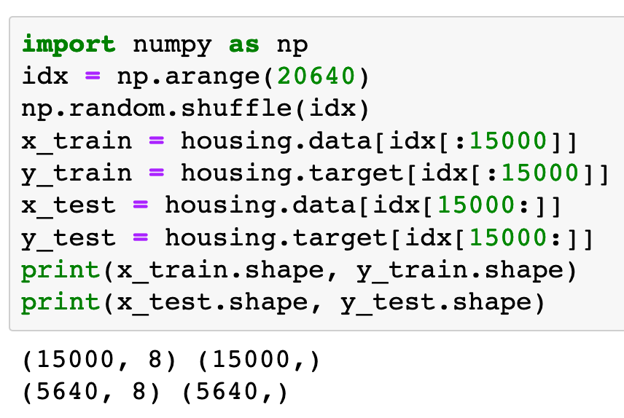

Slide 8
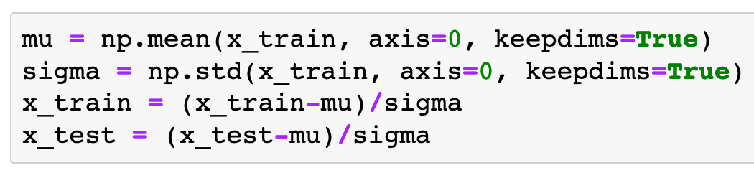
Input Normalization (Optional)

Slide 9
Warm Up

Slide 10
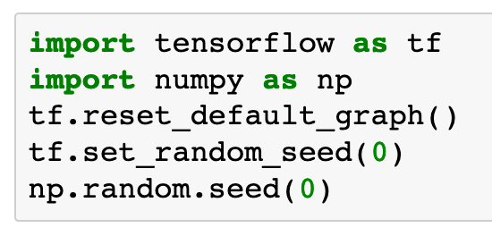

Slide 11

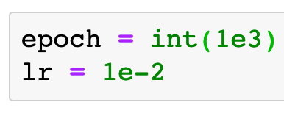
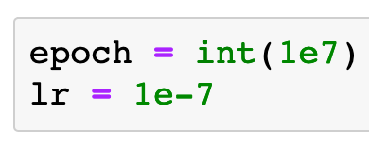
With Input Normalization
Without Input Normalization

Slide 12
With Input Normalization
Without Input Normalization

Slide 13
With Input Normalization
Without Input Normalization

Slide 14
Graph

Slide 15
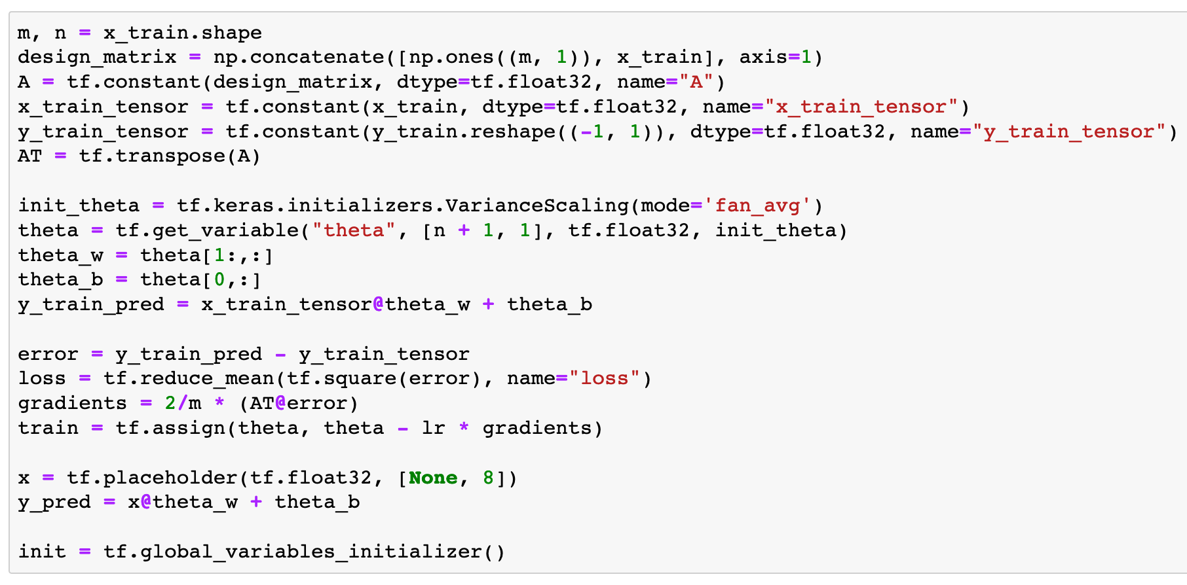

Slide 16
Session

Slide 17
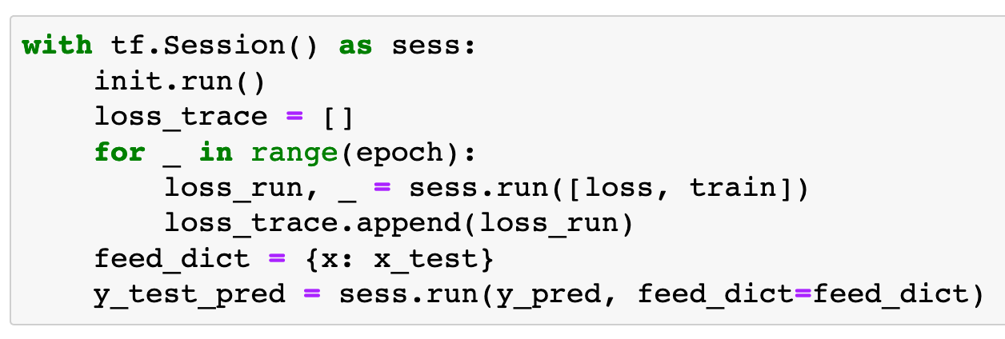

Slide 18
Report

Slide 19
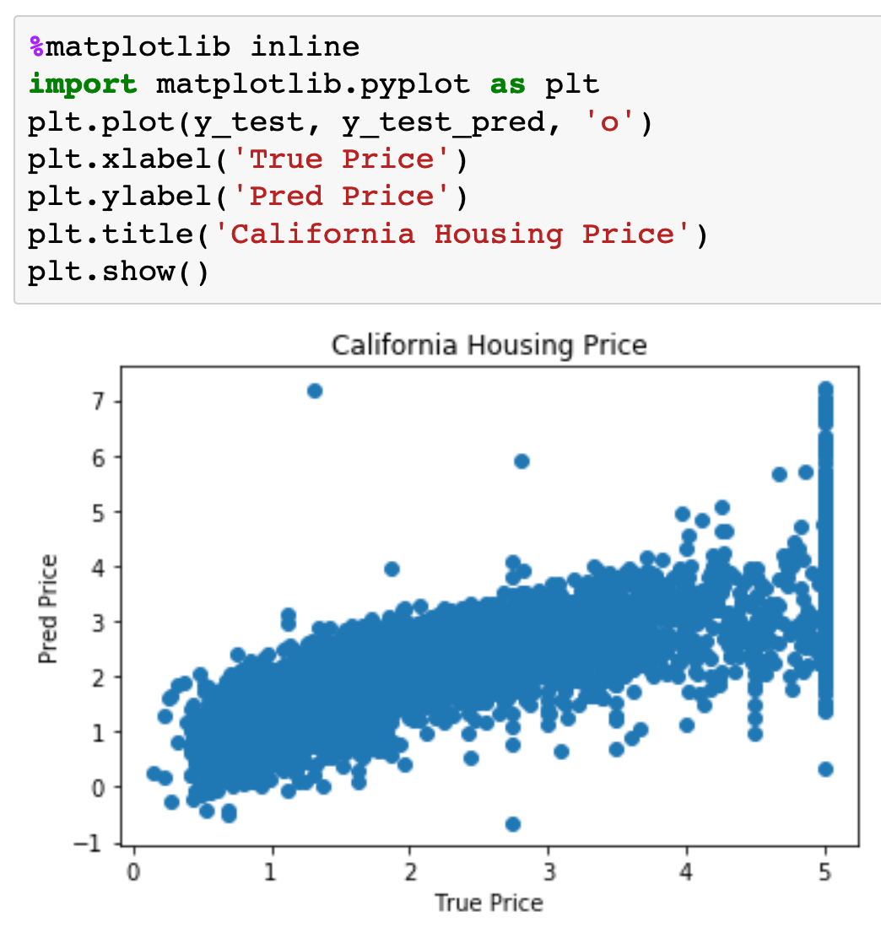
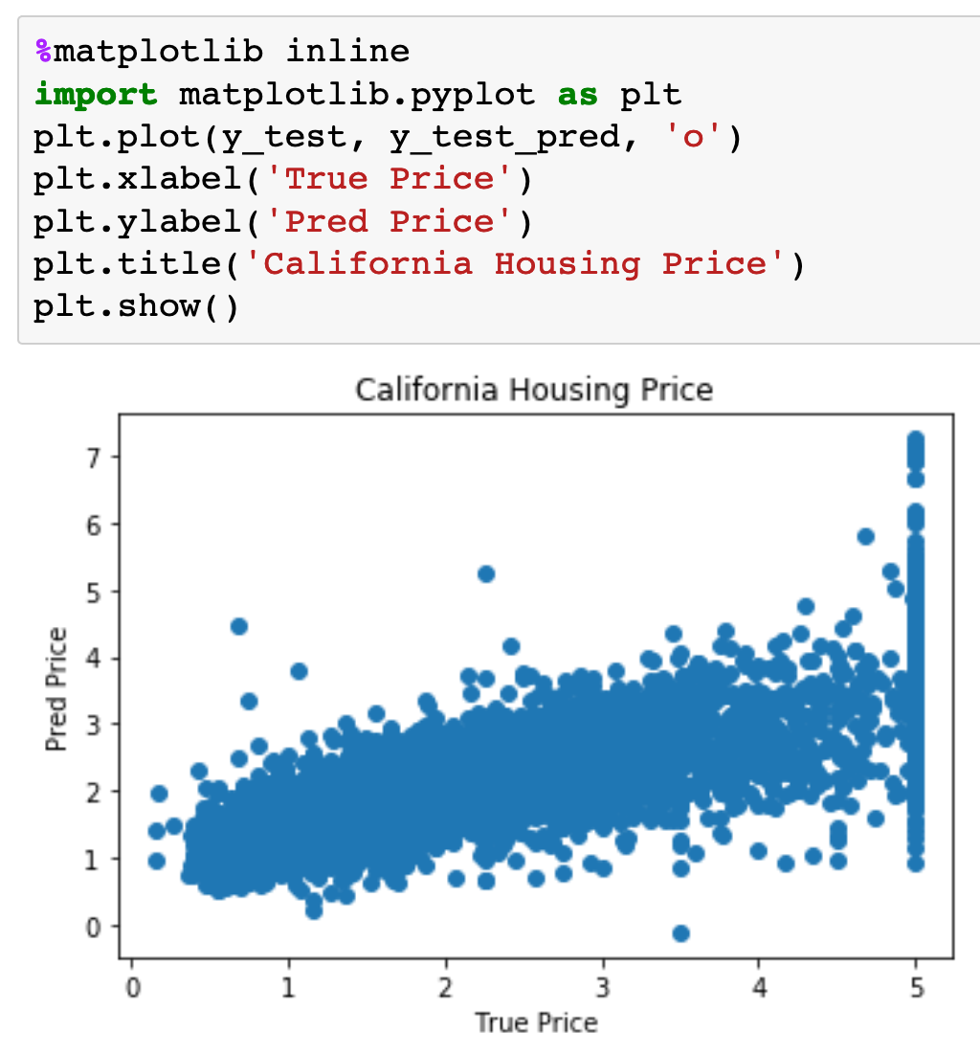
With Input Normalization
Without Input Normalization

Slide 20
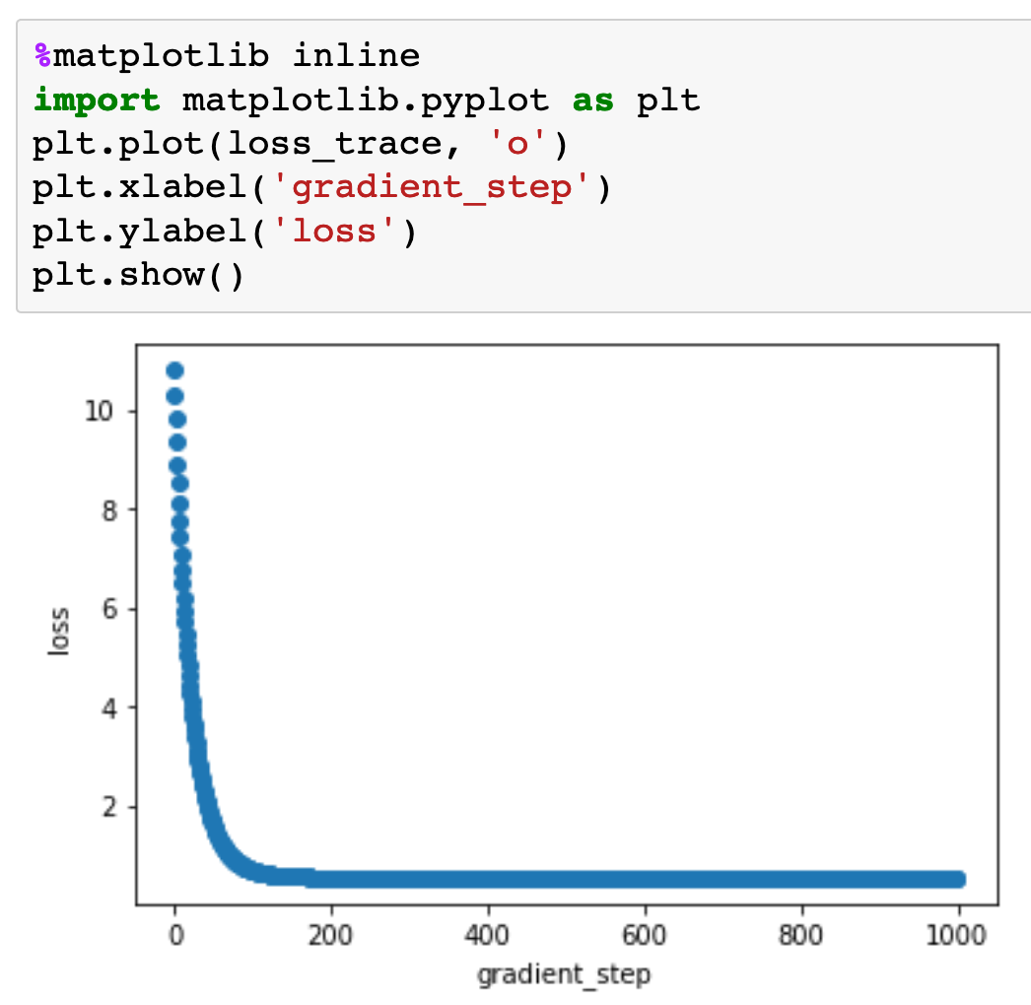
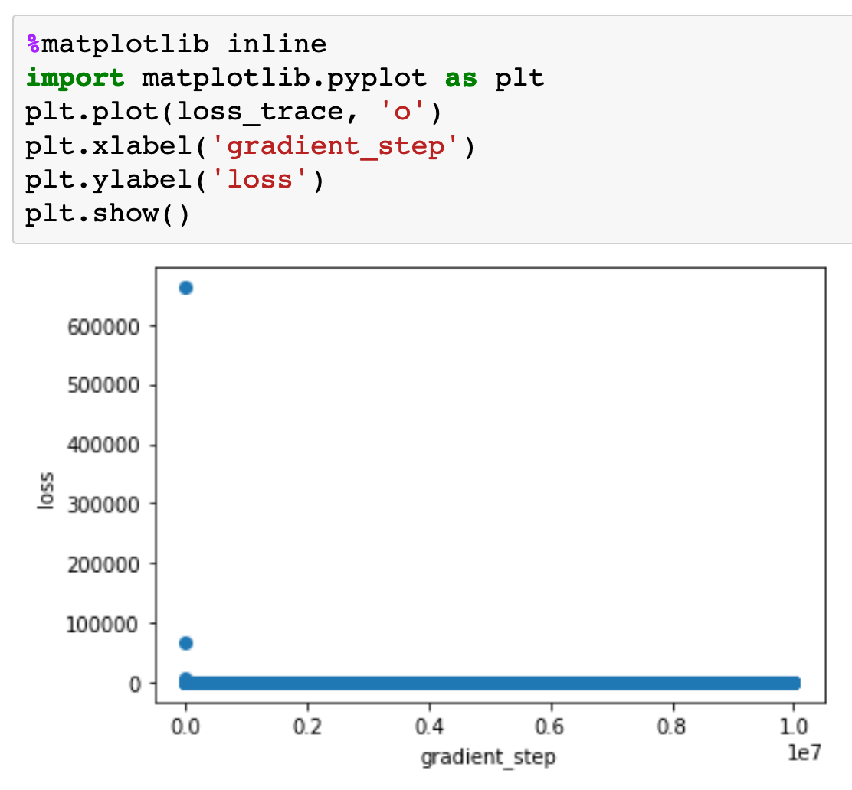
With Input Normalization
Without Input Normalization

Slide 21
With Input Normalization
Without Input Normalization

Slide 22
With Input Normalization
Without Input Normalization

Slide 23
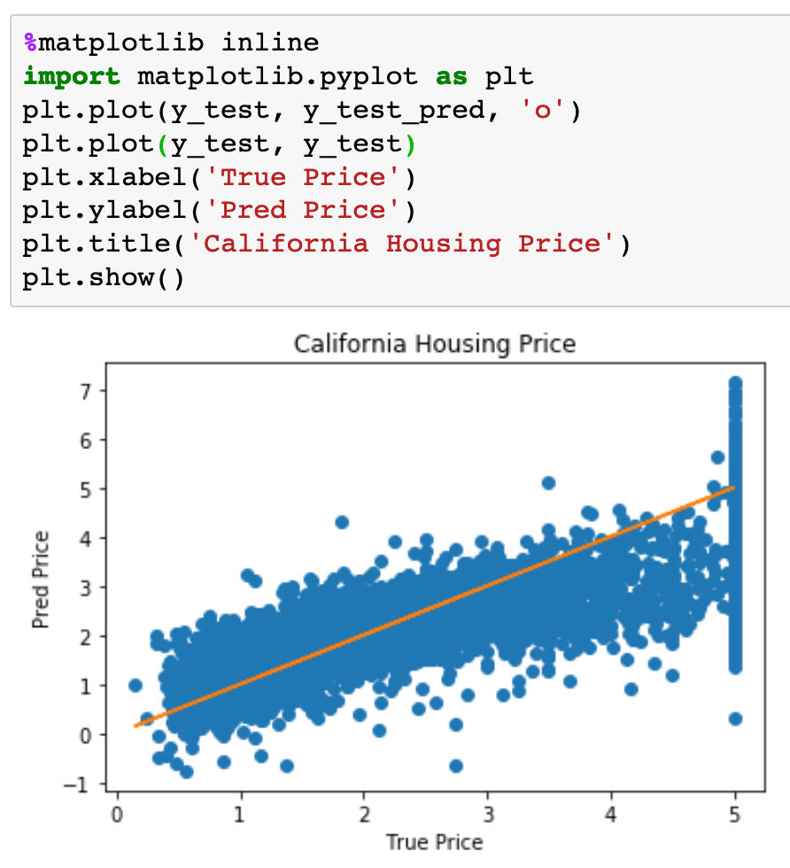
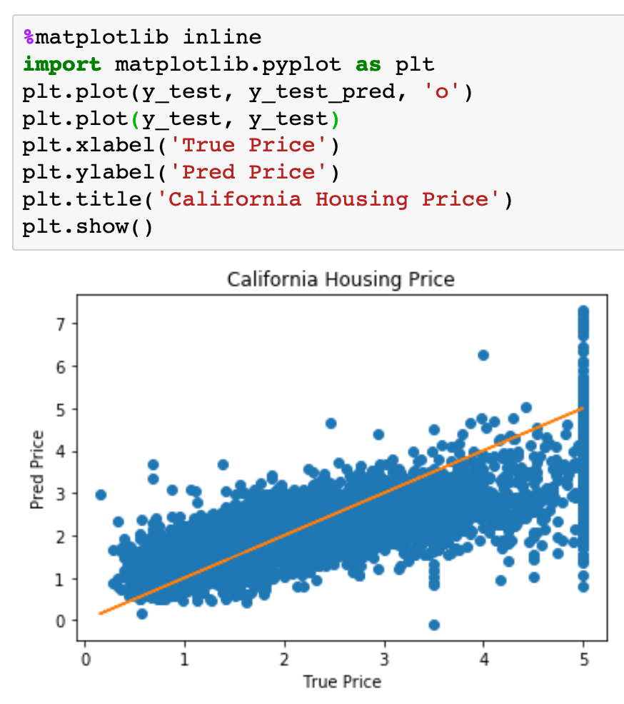
With Input Normalization
Without Input Normalization

Slide 24
With Input Normalization
Without Input Normalization

Slide 25
Now
Let’s Play with Code

